Slide 1
Justice-based Arguments for Market Shaping
Lukas Fuchs
IIPP Research Seminar
25th March 2020

Slide 2
Overview
Situating the paper
The Moral Limits of Markets
Beyond Exchange
Conducive Markets
Market Shaping

Slide 3
Situating the Paper
- Chapter 2: Worry of Paternalism
- Chapter 3: Worry of Autonomy
- Chapter 4: Evaluation of markets
- Chapter 5: Climate Change

Slide 4
One of the appeals of markets, as a public philosophy, is they seem to spare us the need to engage in public arguments about the meaning of goods. So markets seem to enable us to be non-judgmental about values. But I think that's a mistake.
"Michael Sandel: 'We need to reason about how to value our bodies, human dignity, teaching and learning’” The Guardian, May 27, 2012.

Slide 5
The Moral Limits of Markets
Evaluation of market economy vs particular markets (such as energy market)
Much discussion of market economy (rights, liberty, stability, equality, autonomy)
Rawls, Nozick, Gray, Tomasi, Cohen etc.
Particular markets: Moral limits of markets

Slide 6
The Moral Limits of Markets
Which market transactions are morally problematic?
Freedom of contract as general presumption whose exception requires justification
Essentialist (Anderson 1993, Sandel 2000) vs non-essentialist accounts (Satz 2010)

Slide 7




Slide 8
Beyond Exchange
1st Limitation of Literature: Focus on Exchange
Production, Innovation, Entrepreneurship, Consumption
Moral badness of markets may lie in these other aspects
Further limitations: long-term & interrelations

Slide 9
Conducive Markets
2nd limitation: The moral limits of markets
Shift from from markets that are too bad to exist to markets that are too good not to exist
From ‘obnoxious’ to ‘conducive’ markets
Shift from evaluative reaction to bad markets to imagining new markets – made possible, for example, by new technologies

Slide 10
Conducive Markets
Satz’ evaluative dimensions for obnoxious markets:
1) Negative Consequences on individuals (participating or third parties)
2) Negative Consequences on society
3) Weak agency (lack of knowledge, lack of agency)
4) Vulnerability (weak bargaining power)

Slide 11
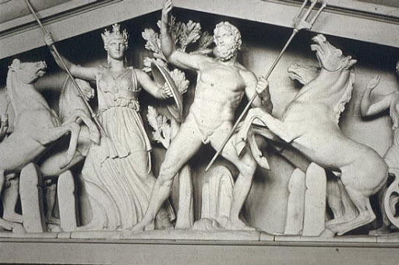
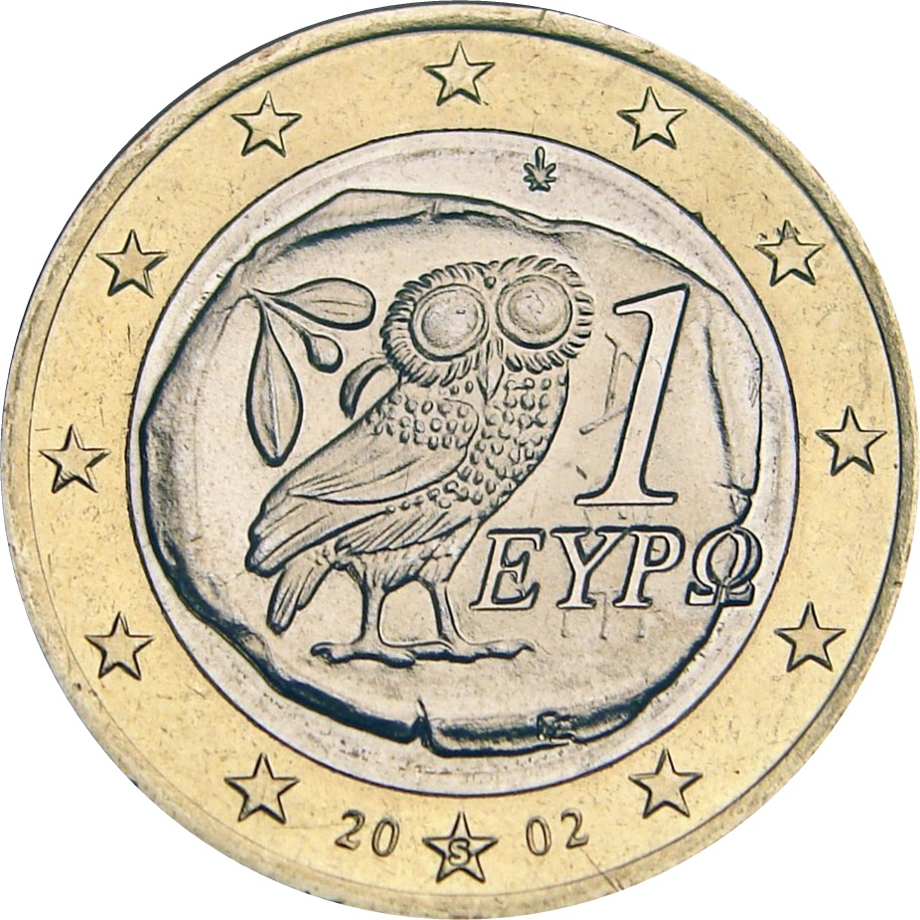
Conducive Markets
Economic prosperity

Slide 12
Conducive Markets
Economic prosperity
Republican Liberty
“commerce and manufactures gradually introduced order and good government, and with them, the liberty and security of individuals, among the inhabitants of the country, who had before lived almost in a continual state of war with their neighbours and of servile dependency upon their superiors. this, though it has been the least observed, is by far the most important of all their effects” – A. Smith, Wealth of Nations

Slide 13
Conducive Markets
Economic prosperity
Republican Liberty
Fair equality of (economic) opportunities

Slide 14
Conducive Markets
Economic prosperity
Republican Liberty
Fair equality of (economic) opportunities
Intergenerational Justice

Slide 15
Market Shaping
3rd limitation: passive, merely legal nature of the state
blocking, regulating, gov failure
Industrial policy, state as producer, missions
Caney (2010): first and second order responsibilities for fighting climate change
“A market shaping policy is a policy aimed at creating markets that were previously absent due to technological limitations, economic viability or perception of risk.”

Slide 16
Thank you!

