Slide 1
Innovation, Economic Growth and Social Progress
Lukas Fuchs
Conference: Turn Over a New Leaf. Innovations, Pseudo-Innovations and Corporate Social Responsibility for the Future
13th June 2020

Slide 2
[We do] not require continual economic growth over generations to maximize upward indefinitely the expectations of the least advantaged. That would not be a reasonable conception of justice. We should not rule out Mill’s idea of a society in a just stationary state.
John Rawls: Justice as Fairness, 2001.

Slide 3
Growth as Strategy for Justice
Right-Rawlsian critique: Brennan (2007), Tomasi (2012)
Brennan: If you want to maximise prospect of least well-off, maximise growth. Therefore,
  Market-based economy (market ensures growth)
  Material wealth matters (what else?)
  Growth = higher income = higher wellbeing

Slide 4
Growth, but how?
Growth: yes!
Details?
  Who produces growth?
  What makes growth desirable?
  Which growth is desirable?

Slide 5
Which growth is desirable?
Developing countries: material wealth
All countries: Inequality, climate change, Covid-19, automation
How can growth help tackle grand challenges?

Slide 6
Innovation-led growth
What money can buy, depends on state of technology and markets
Mansa Musa (c. 1280 – c. 1337): kind of Mali, richest man in history
Growth should not be merely quantitative, but also qualitative.
Schumpeter: creative destruction.

Slide 7
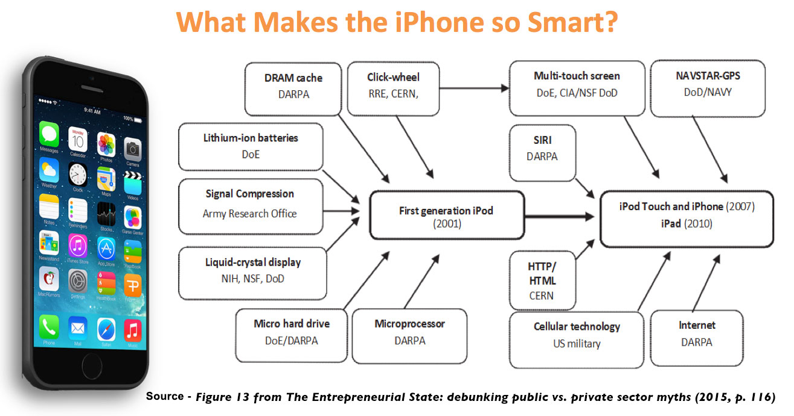

Slide 8
The Entrepreneurial State
Innovation is collective (state, market, third sector)
Symbiotic public – private collaborations
Missions, national innovation systems, the developmental state (Chang, Wade), the entrepreneurial state (Mazzucato)

Slide 9
Thank you!

